Slide 1

Using Visual Studio Tools for Apache Cordova to Create Multi-Platform Applications
Kevin Ford
Mobile Practice Lead,
Magenic

Slide 2
KevinF@magenic.com
@Bowman74
http://windingroadway.blogspot.com
https://github.com/Bowman74
Kevin Ford
Notes:
Generally the closer to native you get the better the potential user experience
Tools like Xamarin use native UI technologies and generally offer day one support for most new features
However, many tools are made for “true” native technologies, such as tools that wrap apks may work better with true native technologies
True native technologies represent the OS creator’s preferred way of writing applications for the OS
True native tools are free

Slide 3
Mobile Tasks Source Code
GitHub
https://github.com/Bowman74/VSLiveIntroToTACO
Notes:
Generally the closer to native you get the better the potential user experience
Tools like Xamarin use native UI technologies and generally offer day one support for most new features
However, many tools are made for “true” native technologies, such as tools that wrap apks may work better with true native technologies
True native technologies represent the OS creator’s preferred way of writing applications for the OS
True native tools are free

Slide 4
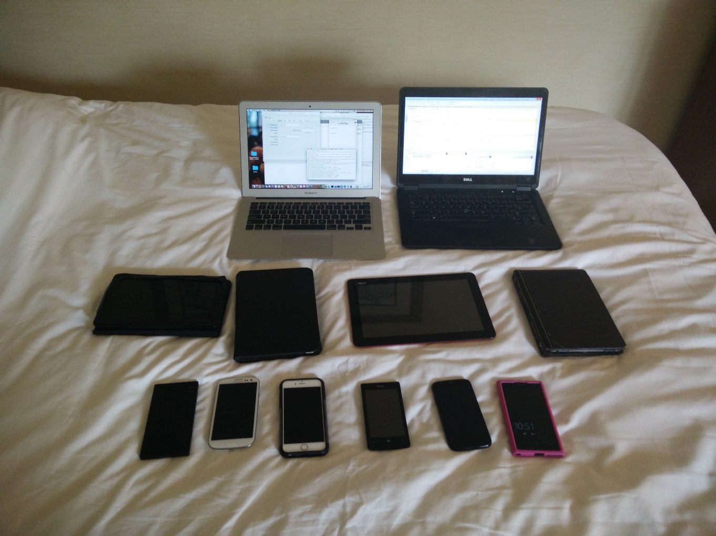
Notes:
Mobile Developers work with a wide variety of apps

Slide 5

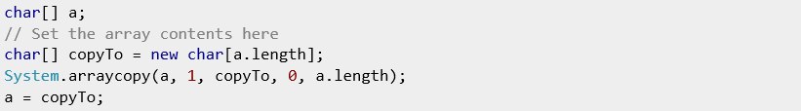
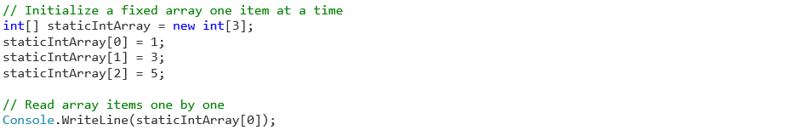
The Mobile Development Problem
iOS
Objective-C/Swift/Xcode
Android
Java/Android XML
WinRT
C# .NET/XAML
C++/XAML
Html5/JS
Windows Phone
C# .NET/XAML
C++/XAML
Html5/JS
5

Slide 6
Development Options
Mobile Enabled Web
Hybrid
True
Native
Near Native
HTML5/JS
Cordova
Xamarin
Java-Android
Objective-C /iOS
Notes:
Generally the closer to native you get the better the potential user experience
Tools like Xamarin use native UI technologies and generally offer day one support for most new features
However, many tools are made for “true” native technologies, such as tools that wrap apks may work better with true native technologies
True native technologies represent the OS creator’s preferred way of writing applications for the OS
True native tools are free

Slide 7
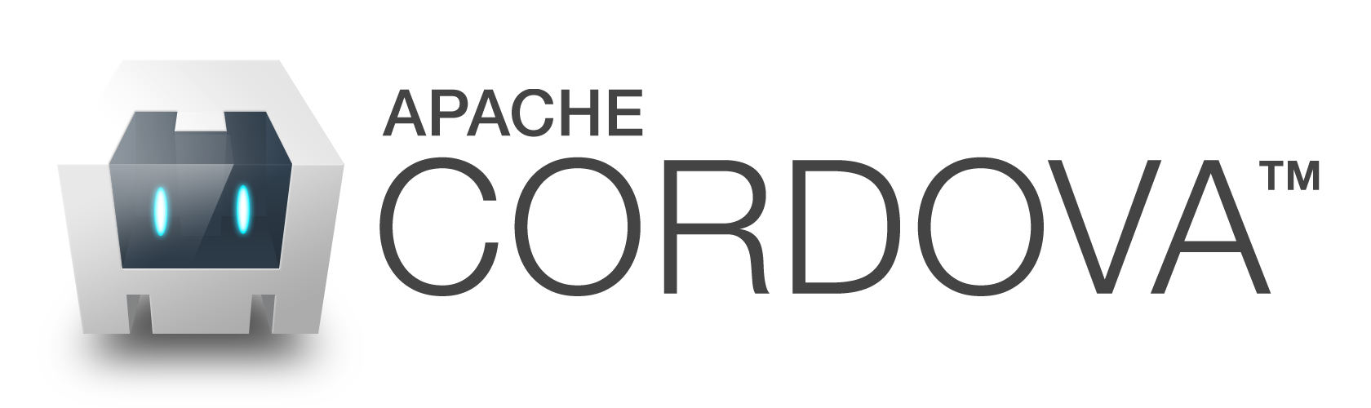
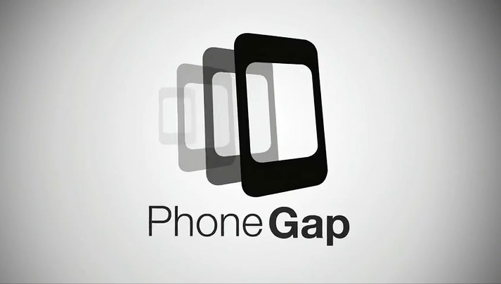

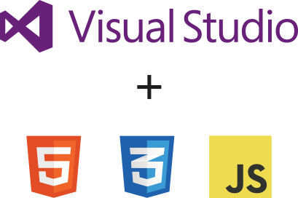
What is
Notes:
Javascript/css/html framework that runs in a native wrapper on a device.
Cordova is open source
Other frameworks built off of it like Telerik’s AppBuilder, PhoneGap and of course VS tools for Cordova
Generally all the same except for elements of the application structure
There are also extra services such as PhoneGap’s build service in the cloud.

Slide 8
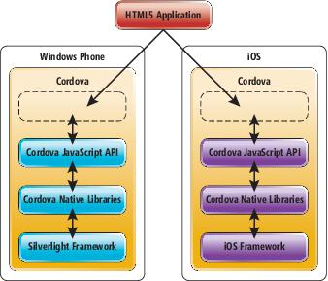
How does Cordova Work?

Slide 9


Supported Platforms?
Notes:
Android 2.3.3 and later (4.4 provides the best developer experience)
iOS 6, 7, and 8
Windows 8 and 8.1
Windows Phone 8 and 8.
Windows Universal

Slide 10





What do I need?
Notes:
This stuff is installed for you.

Slide 11
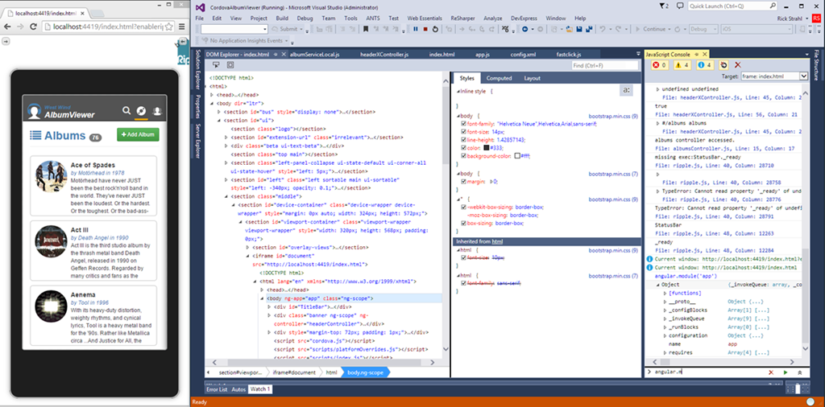
Emulator Options - Ripple

Slide 12
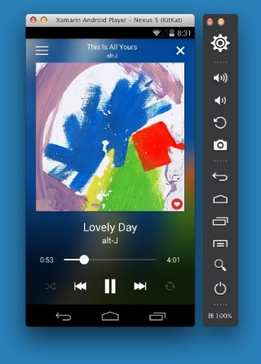
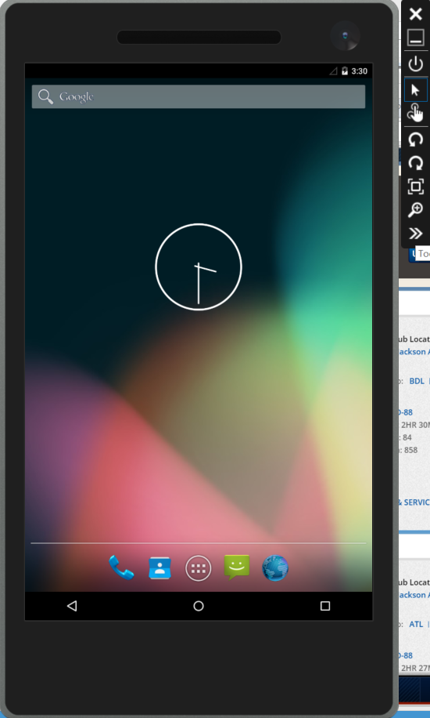
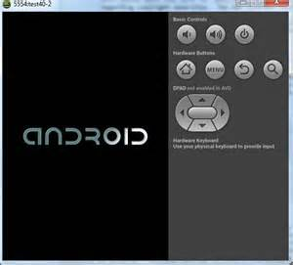
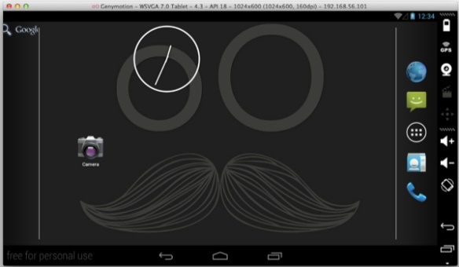
Emulator Options - Android
Mac OS with HAXM Atom
Windows with Hyper-V

Slide 13
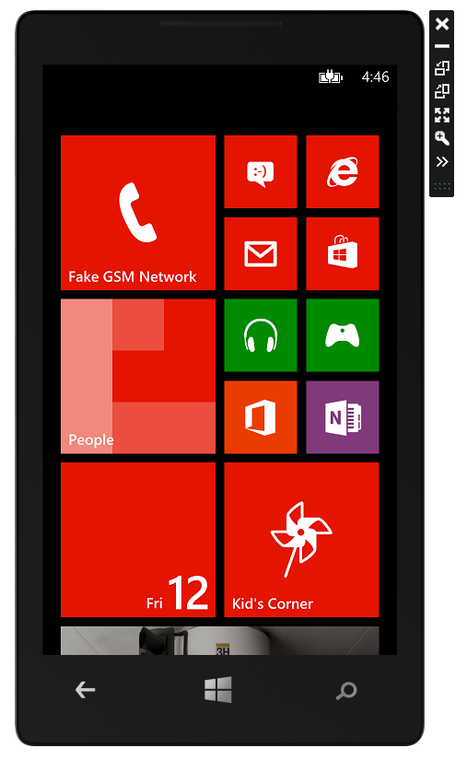
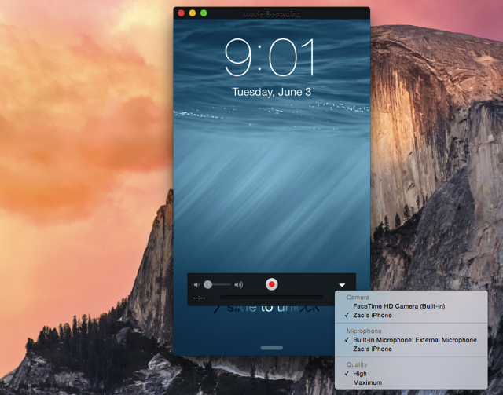
iOS and Windows Phone

Slide 14
Demo 1 : Creating a Project

Slide 15
Cordova Command Line
App title
Name of directory to create project in
App Id
Create a project
cordova create MyProject com.magenic.myProject MyTitle
Add or remove platforms
cordova platform add wp8
cordova platform add windows
cordova platform add amazon-fireos
cordova platform add android
cordova platform add blackberry10
cordova platform add firefoxos
Same commands can be used to remove: cordova platform remove windows

Slide 16

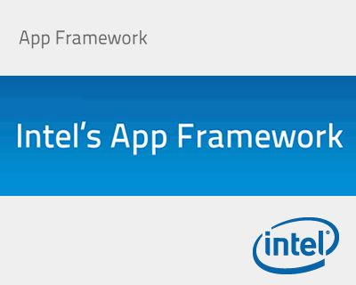






What about the UI?

Slide 17
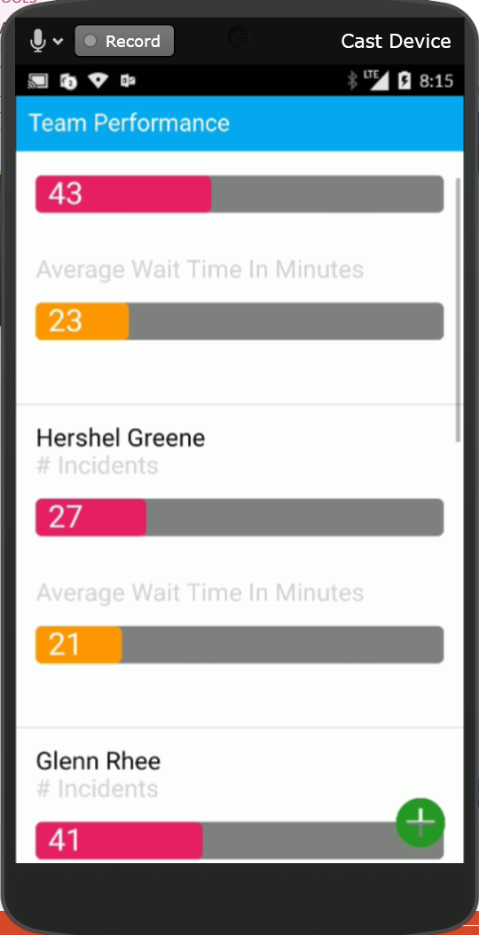
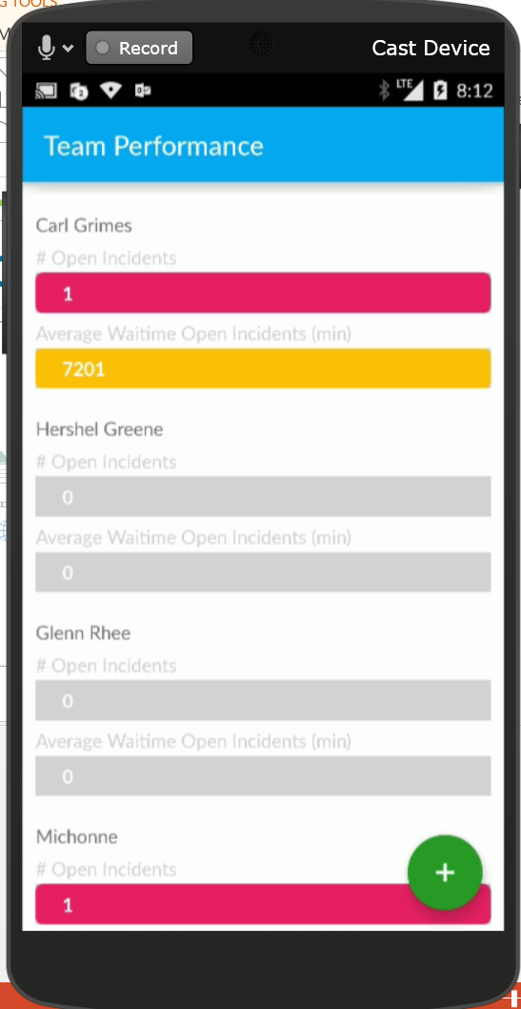
A Tale of Two Apps

Slide 18
Adding an UI Framework

Slide 19
Creating a Page
Basic Structure
Container
<div class=“view">
</div>
Pages
<div class=“pages">
<!-- panels go here -->
</div>

Slide 20
Creating a Page
Panels
<div id="pnlMainMenu" data-title="Cordova App" class="panel" selected="true" style="height: 100%">
Hello World
</div>
List
<ul class="list" id="lstMenuItems" style="width: 100%; height: 100%">
<li>First Item</li>
<li>Second Item</li>
</ul>

Slide 21
Basic Navigation
What you need to send
ID - id of the div to load (can be an Ajax URL)
New Tab - Boolean if you want to reset the history (new tab)
Go back - is this initiating a back transition
Transition - the name of the transition you want to show
Command:
$.afui.loadContent(_div_id,newTab,goBack,transition);
Or
<a href="#pnlGetMaxPrime">Max Primes</a>

Slide 22
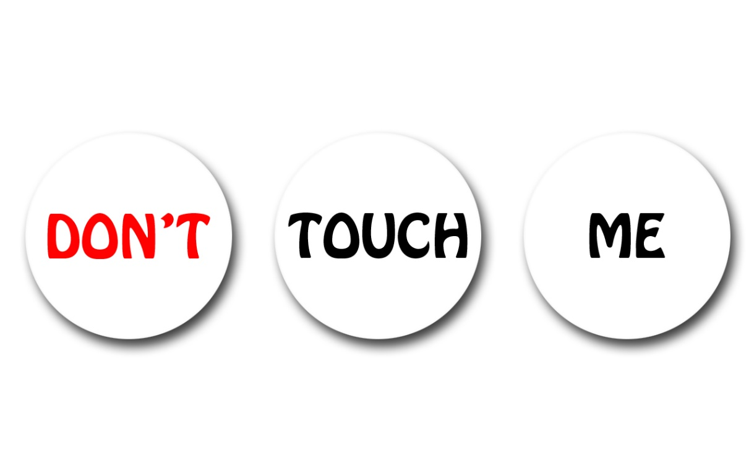
What’s a Double-Click?
No clicks on mobile devices
HTML is designed for a .3 second delay in case of double-click
Use FastClick

Slide 23
Libraries and Scripts

Slide 24
Demo 2 : Adding a UI Framework

Slide 25
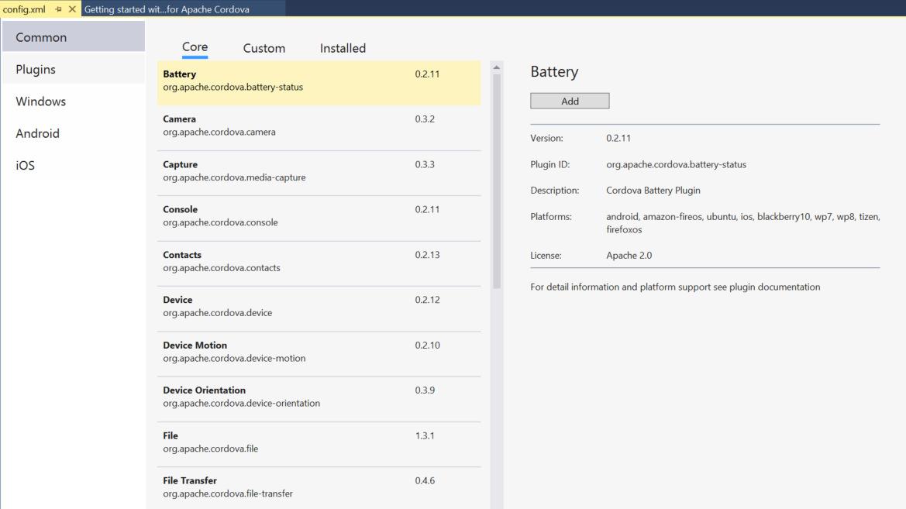
Adding a Plugin
Notes:
Standard plugins
Adding custom plugins
Creating a new plugin
I Haz Cheeseburger?!?!” message Ripple

Slide 26
Demo 3 : Network Plugin

Slide 27
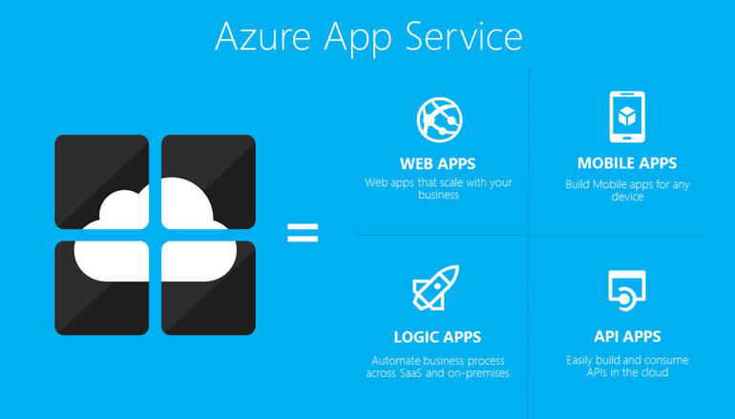
Connecting to Azure

Slide 28
Demo 4 : Connecting to Azure
Notes:
The long list problem

Slide 29
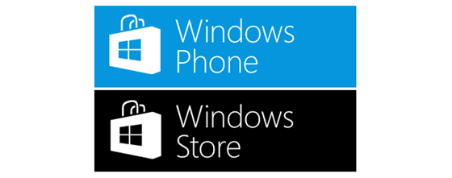
Deploying Your Application

Slide 30
Deploying Your Application
Install Xcode and command line tools
Install Node.js
Install signing certificate
In a terminal window install remotebuild (was vs-mda-remote)
sudo npm install -g remotebuild
Start remote agent
remotebuild [-–secure false]
Set pin in Visual Studio
Notes:
New pin vs-mda-remote generateClientCert
Ctrl-C stop

Slide 31
Demo 5 : Deploying Your Application

Slide 32
Takeaways
Can code for many devices with one code base
Takes work to get user experience right for the device
Click Vs. Touch
OS and Version Differences
Lots of UI Frameworks out there
For iOS there needs to be a Mac somewhere
Plugins can allow you to access device features and handle CPU intensive tasks

Slide 33
Thanks!!!
Kevin Ford
Twitter: @Bowman74
kevinf@magenic.com
http://windingroadway.blogspot.com

